Slide 1
Going deeper, understanding more, unlocking the key words, finding the spiritual principles, making the application personal, and growing in the Lord!
Notes:
NOTE:
To change the image on this slide, select the picture and delete it. Then click the Pictures icon in the placeholder to insert your own image.

Slide 2
Men’s Bible Study
God things happen when men come together in His name!
Mat 18:20 "For where two or three have gathered together in My name, I am there in their midst."
Cape Men 4 Christ

Slide 3
Welcome to Men’s Bible Study
Before we begin, please…
put cell phones in quiet mode
remember to respect sharing as confidential
open in prayer
This Photo by Unknown Author is licensed under CC BY-ND

Slide 4
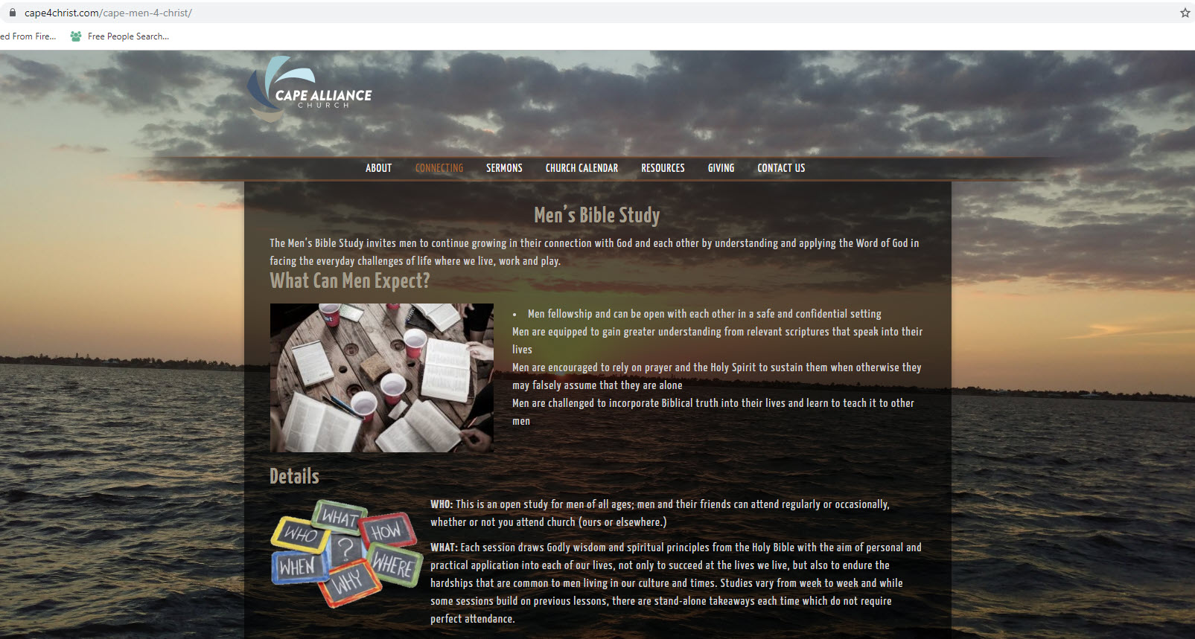
MISSED A MEETING?
https://www.cape4christ.com/cape-men-4-christ/

Slide 5
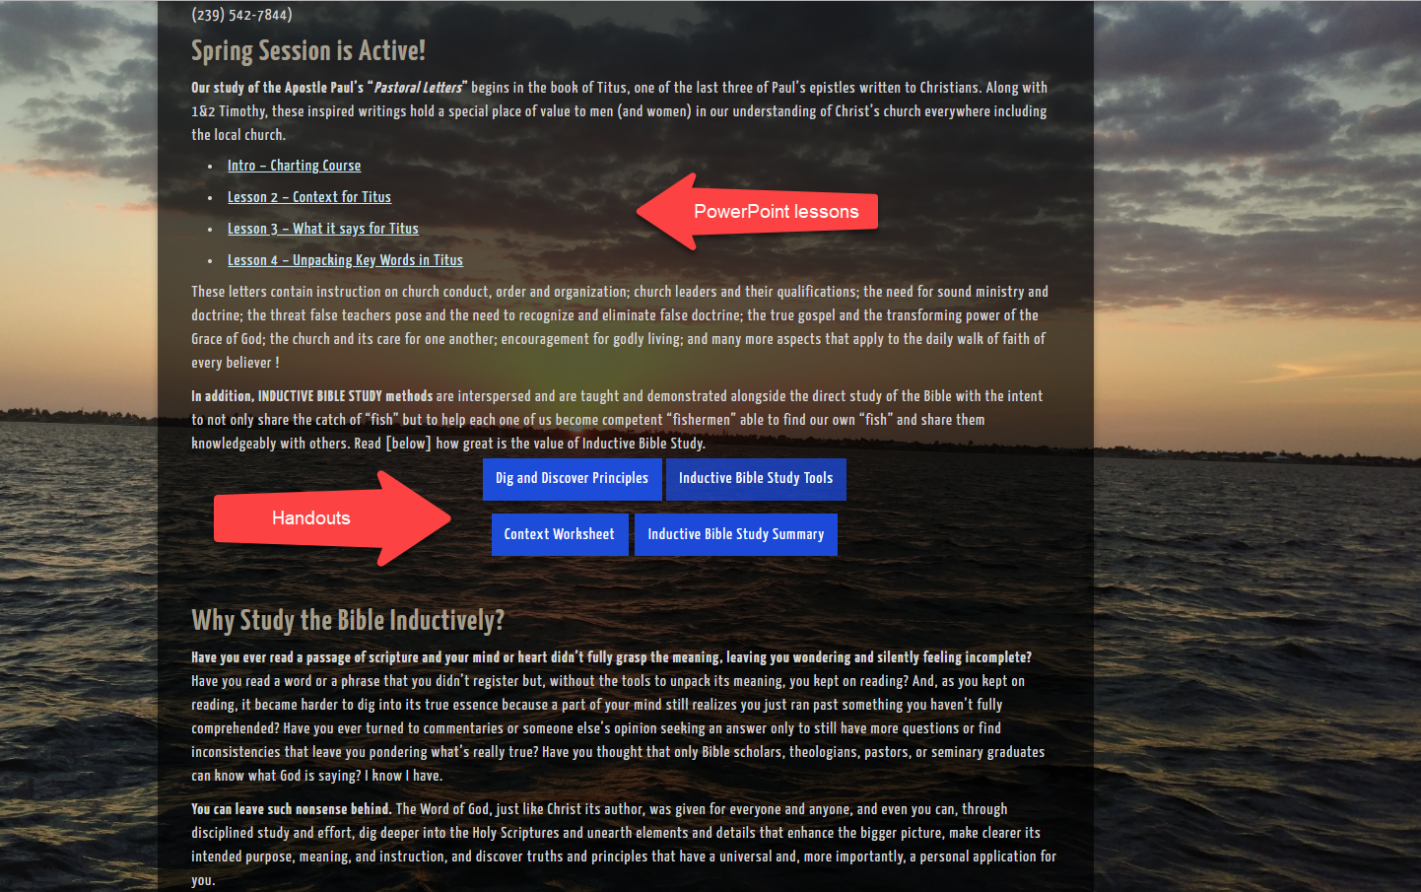
MISSED A MEETING?
https://www.cape4christ.com/cape-men-4-christ/

Slide 6
Going deeper, understanding more, unlocking the key words, finding the spiritual principles, making the application personal, and growing in the Lord!
Notes:
NOTE:
To change the image on this slide, select the picture and delete it. Then click the Pictures icon in the placeholder to insert your own image.

Slide 7
A Step-by-Step Process
Review
Week 1
Preparation & Prayer
Read for the big picture
Understand the context
What does it say?
What does it mean?
Summarize (state the big main idea)
Identify the spiritual principles
So what? Finding the application
Week 2
Week 3
Week 4
Week 5
Week 6
Tonight

Slide 8
Overview: 3 Basic Phases
Observation
Interpretation
Application

Slide 9
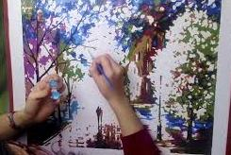
Moving From Interpretation to Application
Application is the finished work; God’s masterpiece
In YOU!

Slide 10
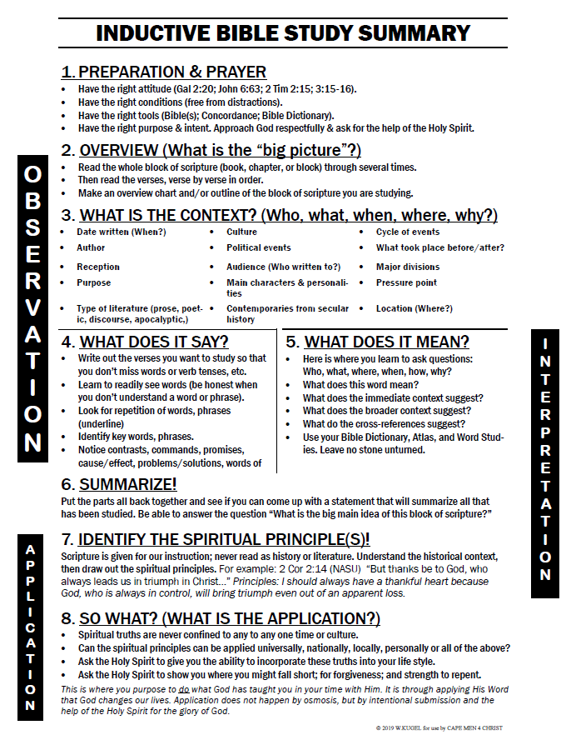
Notice: (Personal) Application
Is a stand-alone process

Slide 11
8. SO WHAT? (WHAT’S THE APPLICATION?)
Spiritual truths are never confined to any to any one time or culture.
Can the spiritual principles be applied universally, nationally, locally, personally or all of the above?
Ask the Holy Spirit to give you the ability to incorporate these truths into your life style.
Ask the Holy Spirit to show you where you might fall short; for forgiveness; and strength to repent.
This is where you purpose to do what God has taught you in your time with Him. It is through applying His Word that God changes our lives. Application does not happen by osmosis, but by intentional submission and the help of the Holy Spirit for the glory of God.

Slide 12
Application: How Do I Respond?
1
The dictionary defines application as the act of putting to use or putting into operation especially for some practical purpose.
In Bible study, application is putting truth you've discovered (through observation and interpretation) to use in your life with the ultimate goal of transformation or life change. Bible study is meant not merely to inform but to transform and renew our mind. (Ro 12:2-note)
Application answers the question, How does the truth of this passage apply to my life?
Note that the question is not "Is this truth relevant to my life?" The truth of God's Word is always relevant to our life. The more honest question is "Am I ready and willing believe this truth and to apply it in my life?"
Application is the most neglected yet the most needed stage in the process. Too much Bible study begins and ends in the wrong place...with interpretation. Interpretation should build on observation and then lead into application. It is a means to an end, not an end in itself. As someone has bluntly phrased it "Interpretation without application is abortion."
Cited: “Inductive Bible Study: Application” retrieved 2/17/20 at https://www.preceptaustin.org/the_key_inductive_study_pt3

Slide 13
Application: How Do I Respond?
2
The goal of Bible study is not simply to determine what it says and what it means, but in the final analysis to apply it to one's life. If we fail to apply the Scriptures, we cut short the entire process and have not finished what God wants us to do.
Inductive Bible study is... Not just for information But for transformation
Jesus warned that Bible study as the end in itself, can be deceptively dangerous declaring to the Jewish leaders...
You search the Scriptures, because you think that in them you have eternal life; and it is these that bear witness of Me and you are unwilling to come to Me, that you may have life.
We must never forget that the ultimate goal of Bible study, whether inductive or otherwise, is to know God and His Son so that we might have life in Him. Jesus emphasized this important truth again in John 17 declaring…
And this is eternal life, that they may know Thee, the only true God, and Jesus Christ whom Thou hast sent. (John 17:3)
Cited: “Inductive Bible Study: Application” retrieved 2/17/20 at https://www.preceptaustin.org/the_key_inductive_study_pt3

Slide 14
Application: How Do I Respond?
3
Heart appropriation, not merely head apprehension, is the true goal of Bible study. Only in this way can believers grow spiritually. Spiritual maturity, in which we become more like Christ, comes not just from knowing more about the Bible. It comes from knowing more about the Bible and applying it to our spiritual needs.
Once you know what the passage means (interpretation), you are responsible to put it into practice in your own life. Accurate interpretation and correct application rest on the accuracy of your observations. Therefore, it is vital that you develop observation skills which might, at first, seem difficult, laborious, and time-consuming. (Persevere!)
So before moving on to the crucial step of application, pause for a time of reflection. Are you ready and willing for God’s Word to cut deeply into your own life (reproof), to lay bare the hidden places of your heart, and to do its work of convicting, convincing, and converting your mind in any and every area? Apply yourself to the Scriptures and the Scriptures to yourself.
Dr. Howard Hendricks remarks that “Application is the most neglected yet the most needed stage in the process. Too much Bible study begins and ends in the wrong place: It begins with interpretation, and it also ends there...Observation plus interpretation without application equals abortion. In other words, every time you observe and interpret but fail to apply, you perform an abortion on the Scriptures in terms of their purpose."
The goal of Inductive Bible study is... Not to make us smarter sinners But to make us more like our Savior
Cited: “Inductive Bible Study: Application” retrieved 2/17/20 at https://www.preceptaustin.org/the_key_inductive_study_pt3

Slide 15
Application: How Do I Respond?
4
D. L. Moody quipped that "Our great problem is the problem of trafficking in unlived truth. We try to communicate what we’ve never experienced in our own lives."
Dr Martyn Lloyd-Jones wrote that "It is a good thing to be a student of the Word, but only in order to be a practiser and experiencer of the Word.“ There should never be a time when we go to the Scriptures without allowing them to change our lives for the better.
Inductive Bible study students should strive to be men and women like Ezra whose pattern was to teach the truth that he had put into practice. What was the result in his life and by way of application what will be the result in our life if we emulate his example? The good hand of the LORD will be upon us even as it was upon Ezra the scribe! Yes, the Scripture (through your Teacher the Spirit) will bestow spiritual blessings, not by knowing but by doing! Like Ezra we should make every effort to handle it accurately and live it out assiduously (with perseverance and care)! If you are a leader (and most of us are leaders in some sphere of influence) remember that a good leader is one who...
Knows the way, Goes the way, and Shows the way.
Cited: “Inductive Bible Study: Application” retrieved 2/17/20 at https://www.preceptaustin.org/the_key_inductive_study_pt3

Slide 16
Example
What it Says | Cross References | What It Means
(Act 1:7) He answered them, "It is not for you to know what times or periods the Father has set by his own authority. | Act_17:26; Deu_29:29; Dan_2:21; Mat_24:36; Mar_13:32; Luk_21:24; Eph_1:10; 1Th_5:1-2; 1Ti_6:15; 2Ti_3:1 | Principle: Some knowledge belongs only to God.

Slide 17
Example
What it Says | Cross References | What It Means
(Act 1:7) He answered them, "It is not for you to know what times or periods the Father has set by his own authority. | Act_17:26; Deu_29:29; Dan_2:21; Mat_24:36; Mar_13:32; Luk_21:24; Eph_1:10; 1Th_5:1-2; 1Ti_6:15; 2Ti_3:1 | Principle: Some knowledge belongs only to God. Personal Application: I will cease speculating about the meaning of something God’s Word is silent about, trusting God, who in His sovereignty knows when or if to reveal it.

Slide 18
Individual reflection,
then
Open discussion
EXERCISE:
Find a spiritual principle in Titus in which you can find a personal application.

Slide 19
Partner Discussions
Share the application God has put on your heart with your partner and ask for his prayers for growth in this/these area(s) of your life.

Slide 20
How do I apply this?
How seriously do you consider your beliefs about God in the overall scheme of your life? The book of Titus reminds us that our beliefs about God impact every decision we make. Sometimes it is difficult for believers today to see the point of getting all worked up about the person and nature of Christ or the doctrine of the Trinity. However, Paul made clear that a church that teaches and preaches sound doctrine will see results in the lives of its people. Not only will people be saved from their sins, but God’s grace will also motivate them to live out that saving faith with renewed and purified lives.
Many churches today focus more on the form of their worship—music styles, lighting, and building designs—than they do on the content of the faith they mean to proclaim. And while the form of a church’s worship is vital to reaching its community for Christ, without a firm base of sound doctrine, the church will lay its foundation in shifting and sinking sand. Make doctrine a priority in your own life, as well as encouraging it in your churches. Nothing is more significant than a solid foundation in Christ. Nothing is more motivational than grace to live a life of good deeds.
-Chuck Swindoll on Titus

Slide 21
Now, mark your calendars….
February 27th, 2019
@7pm
TITUS:
Final Wrap-Up

Slide 23
Prayer
To find our personal application
Praises
Prayer Requests

