Slide 1
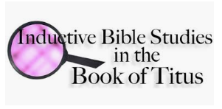
Going Deeper.
Reading with Understanding.
Notes:
NOTE:
To change the image on this slide, select the picture and delete it. Then click the Pictures icon in the placeholder to insert your own image.

Slide 2
Men’s Bible Study
God things happen when men come together in His name!
Mat 18:20 "For where two or three have gathered together in My name, I am there in their midst."
Cape Men 4 Christ

Slide 3
Welcome to Men’s Bible Study
Before we begin, please…
put cell phones in quiet mode
remember to respect sharing as confidential
open in prayer
This Photo by Unknown Author is licensed under CC BY-ND

Slide 4
What we’ll cover
In tonight’s lesson:
We’ll get an overview of Inductive Bible Study methods.
Collaboratively we’ll learn (hands on) to outline or “chart” the book of Titus.
We’ll set our sights on next week’s study.
Cape Men 4 Christ

Slide 5
Going Deeper.
Reading with Understanding.
Notes:
NOTE:
To change the image on this slide, select the picture and delete it. Then click the Pictures icon in the placeholder to insert your own image.

Slide 6
As we begin…
Let’s listen to a short clip of excerpts from Charles Spurgeon’s sermon

Slide 7
Inductive Bible Study
One practical set of tools for “understanding” scripture is…
(Purpose, summary)
Going deeper, understanding more, unlocking the key words, finding the spiritual principles, making the application personal, and growing in the Lord!

Slide 8
Why study the Bible?
“The Bible is the foundational element in a Christ-directed life, and it is from the Bible that you learn all of the other basics for the Christian life. As God speaks to you through the Scriptures, you come to know Him and to love Him, to understand and obey His principles for life and ministry. When you have a vital personal intake of the Word of God, you will grow spiritually.”
-One to One Discipling, Multiplication Ministries

Slide 9
Why, inductive Bible study?
Do you long for a deeper, more meaningful relationship with God, but seem lost when you open your Bible? Do you read portions here and there, but forget what it said five minutes later? Are you frustrated with getting everyone else's opinions about what the Bible says on a certain subject, and wondering what's really true? Do you think it's really possible to understand Scripture even if you aren't a theologian?
The Bible study method I am about to share with you revolutionized my life.
How to Have an Inductive Bible Study
by Brenda Klemke

Slide 10
Benefits of Inductive Study…
Why Inductive Bible Study?
“Inductive Bible study is learning how to exegete the Bible for all its worth with our best efforts. We do this through teaching people tools and skills to help observe the text, dig out the meaning, and then apply it to their lives. Thus, inductive Bible Study enhances the exegesis process by enabling us to read the Bible for more impact, value and significance. In practice, we first examine the ideas and words of the text, then this leads us to the meanings and interpretations, and then we are led to the conclusions and applications.”
-Into Thy Word

Slide 11
Overview: 3 Basic Phases
Observation
Interpretation
Application

Slide 12
A Step-by-Step Process
Use your bookmark for a reminder & reference
Preparation & Prayer
Read for the big picture
Understand the context
What does it say?
What does it mean?
Summarize (state the big main idea)
Identify the spiritual principles
So what? Finding the application

Slide 13
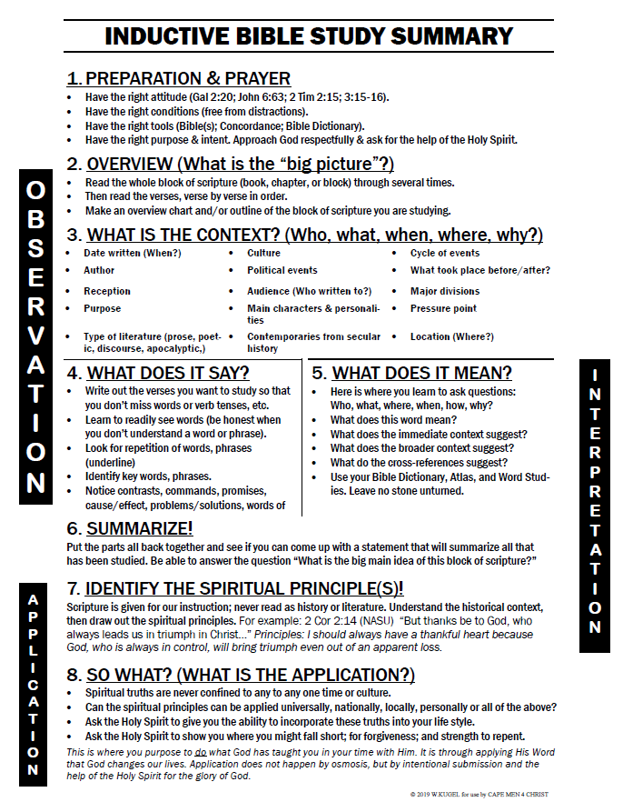
Use IBS Summary as a Quick Reference Guide
LET’S START NOW

Slide 14
PREPARATION & PRAYER
Use your bookmark as a reminder
Have the right attitude, mindset.
(Gal 2:20; John 6:63; 2 Tim 2:15; 3:15-16).
Have the right conditions.
(free from distractions).
Have the right tools.
(Bible(s); Concordance; Bible Dictionary, etc.).
Have the right purpose & intent.
(Approach God respectfully; ask for the help of the Holy Spirit.)

Slide 15
Approach God’s Word Mindful…
…of our salvation.Gal 2:20 I have been crucified with Christ; it is no longer I who live, but Christ lives in me; and the life which I now live in the flesh I live by faith in the Son of God, who loved me and gave Himself for me. (NKJV)
…that the Word brings us into the presence of the Spirit. The John 6:63 It is the Spirit who gives life; …The words that I speak to you are spirit, and they are life. (NKJV)
…to be diligent. 2 Tim 2:15 Be diligent to present yourself approved to God, a worker who does not need to be ashamed, rightly dividing the word of truth. (NKJV)
…that the Word is from God and bears fruit. 2 Tim 3:16 All Scripture is inspired by God and profitable for teaching, for reproof, for correction, for training in righteousness; 17 so that the man of God may be adequate, equipped for every good work. (NASU)

Slide 16
1st Reading: The Big Picture
Read the whole block of scripture
Re-read, write out verse by verse
Make an Outline, Overview Chart
VERSES | Gal 1,2 | Gal 3,4 | Gal 5,6
SUBJECT | The Apostle of Justification | The Principles of Justification | The Privileges of Justification

Slide 17
OPEN discussion: LET’S COLLABORATE
GROUP TASKS:
1: Read the book through.
2. After reading the book thru, how would you chart the main sections or blocks of scripture?
This Photo by Unknown Author is licensed under CC BY-SA-NC

Slide 18
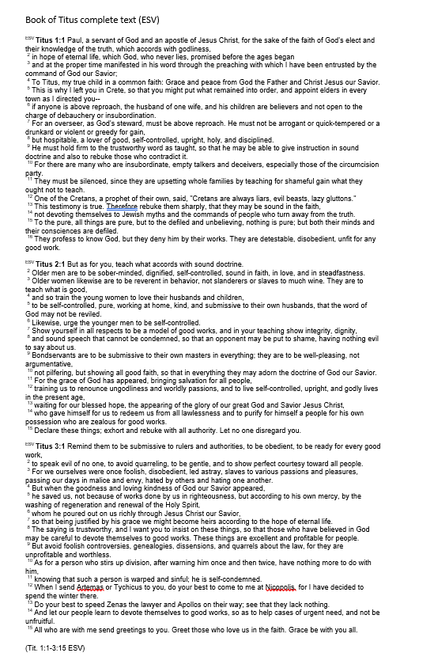
USE YOUR HANDOUT
For this exercise
Where are the breaks?
What are the main sections?
How would you outline or chart this book?

Slide 19
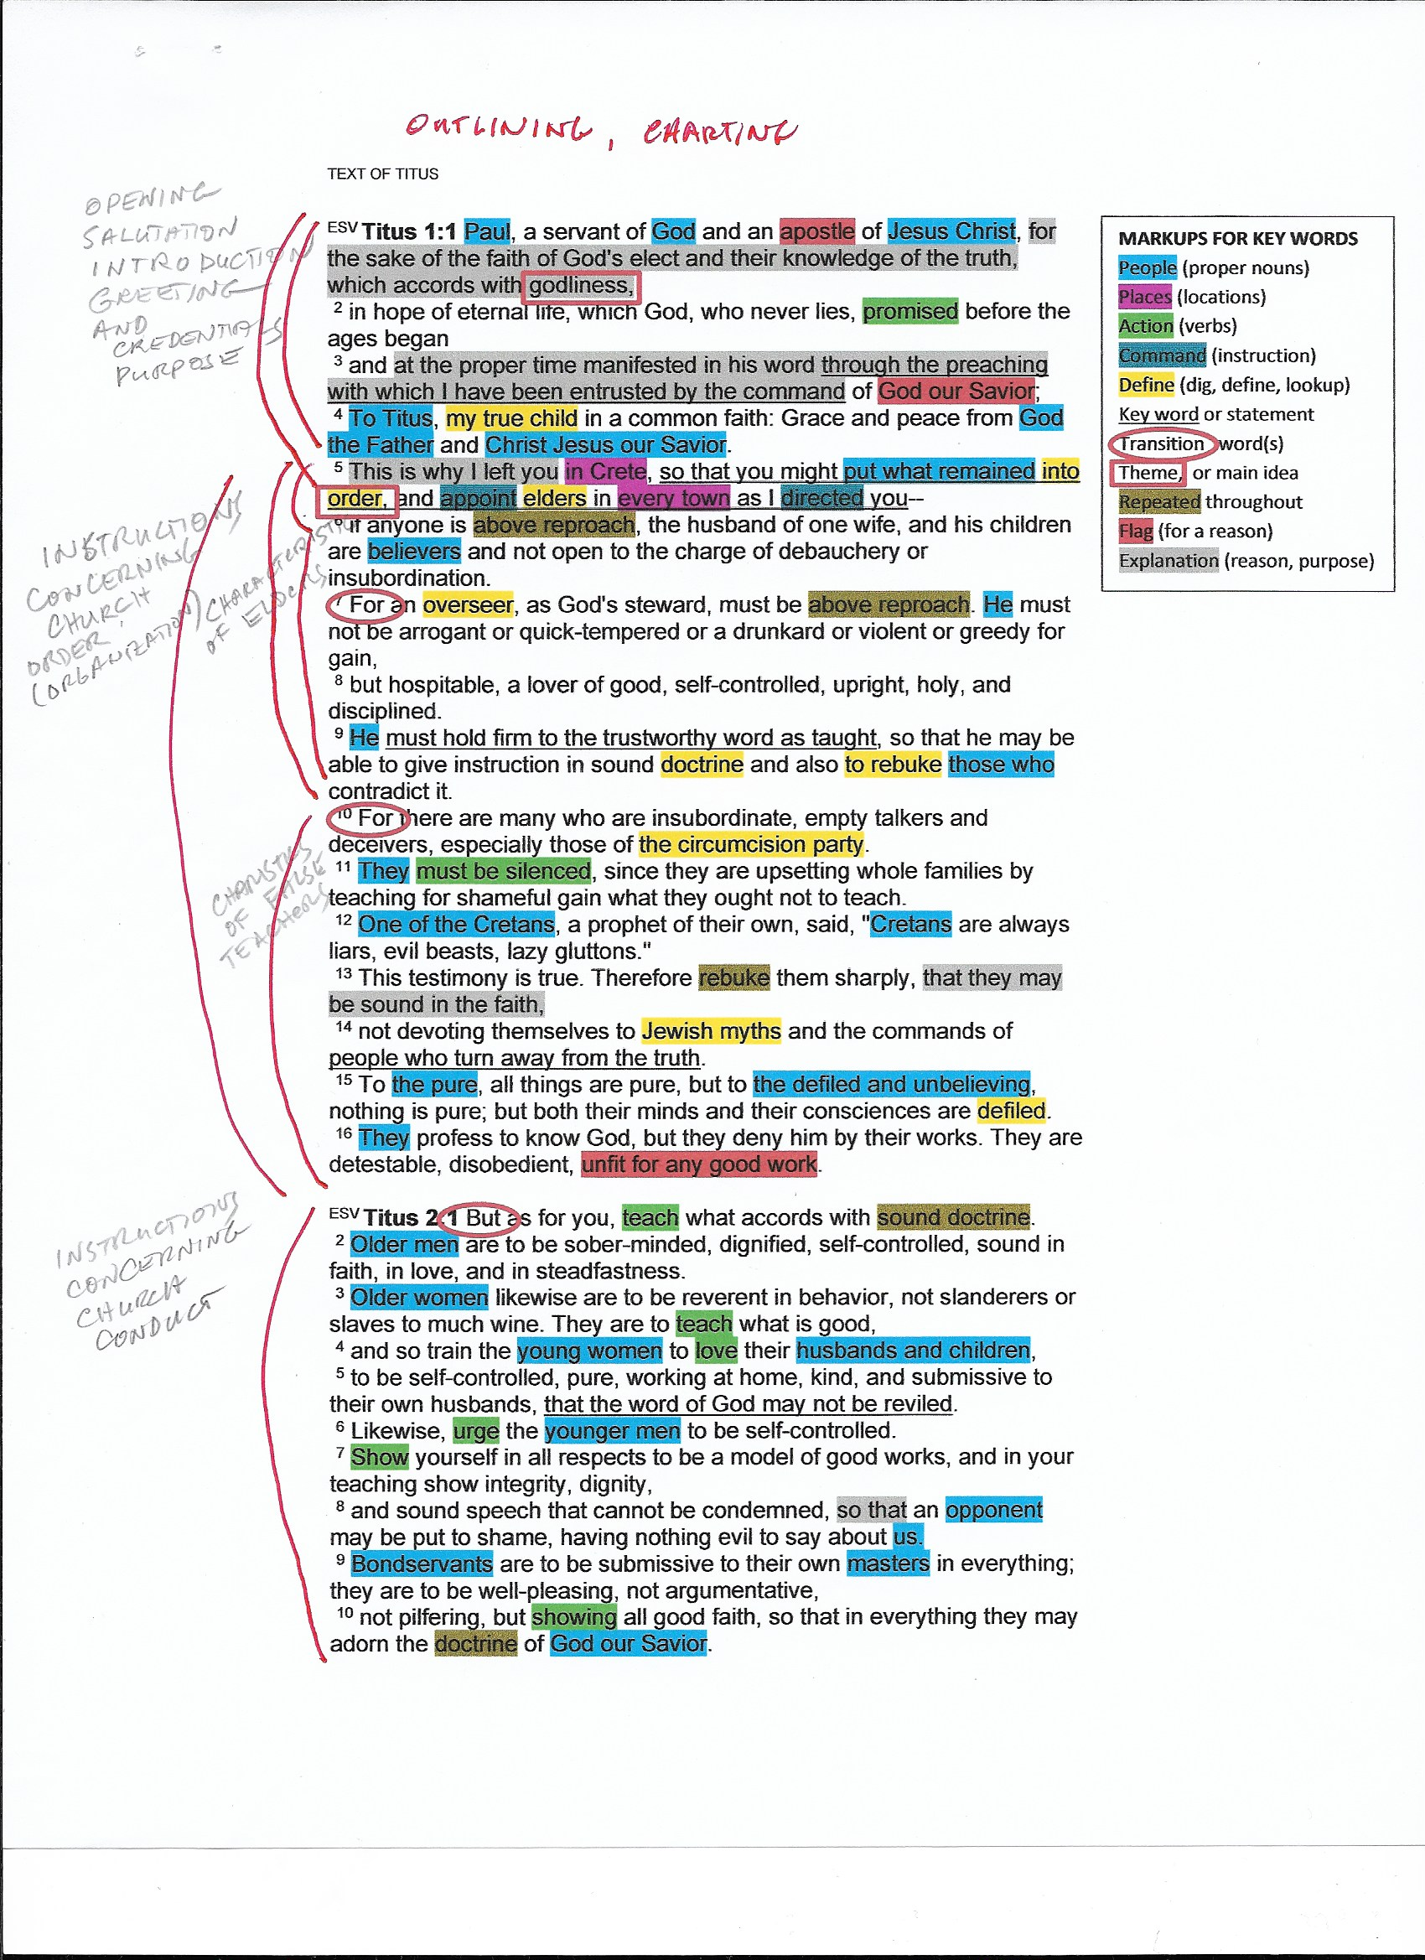
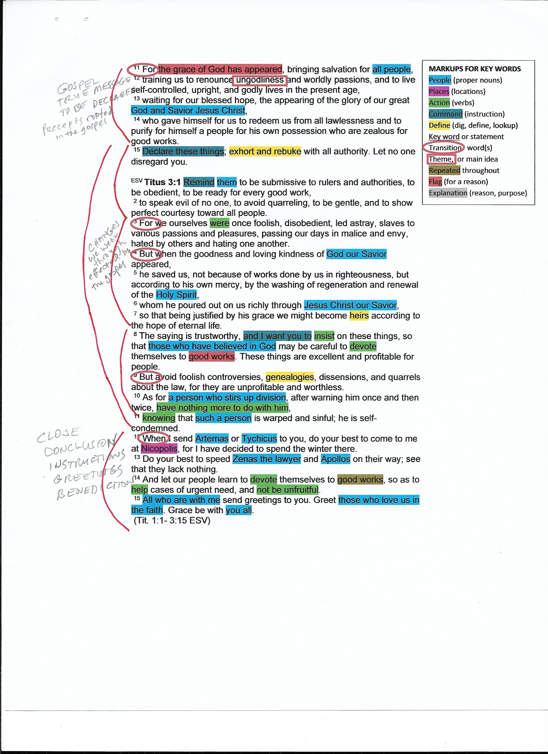
An example a worksheet in process…

Slide 20
A SIMPLE OUTLINE MIGHT LOOK LIKE THIS
Titus
1:1-4
1:5-2:10
1:5
1:6-9
1:10-16
2:1-10
2:11-3:7
2:11-14
2:15-3:2
3:3-7
3:8-11
3:12-15
God’s Church Has Order & Godliness
Introduction
Order Overseen by Sound Leaders Teaching Sound Doctrine
Paul’s Charge to Titus’s & His Mission
Characteristics of Elders (Leaders, Mature Believers)
Conduct/Characteristics of False Teachers
Conduct/Characteristics in an Orderly Church
Order Comes by the Power of the Gospel of the Grace of God
Salvation renounces ungodliness
Exhort and Rebuke, Remind them of the Gospel
Believers, once ungodly, are now the Examples
Good Works are the Evidence of an Orderly Church
Closing Instructions

Slide 21
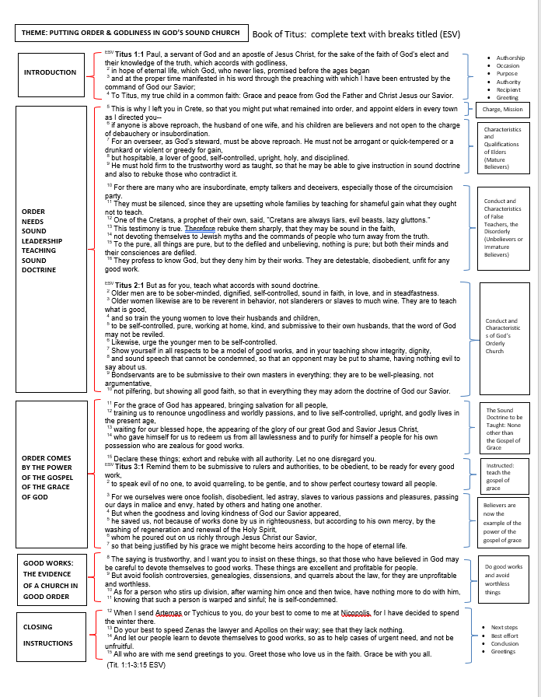

Slide 22
BOOK OF TITUS OUTLINE CHART
Might Look Like This

Slide 23
PREP FOR NEXT WEEK
Re-read Titus
Find clues to context
(in the Bible)

Slide 24
Now, mark your calendars….
January 16th, 2019
@7pm
Developing the Context of the book of Titus
(During the week: Re-read Titus and find clues to its “context”.)

Slide 25
Prayer
To succeed
in applying
God’s Word
Praises
Prayer Requests

